Slide 1

AI-Powered Digital Marketplace for Upcycling Sri Lanka's Textile Waste
Project ID: R26-IT-081 | Project Proposal Presentation
BSc (Hons) in Information Technology
Sri Lanka Institute of Information Technology

Slide 2


Prof. Dasuni Nawinna
Mr. Nelum Amarasena
Project Supervisor
Project Co-Supervisor

Slide 3



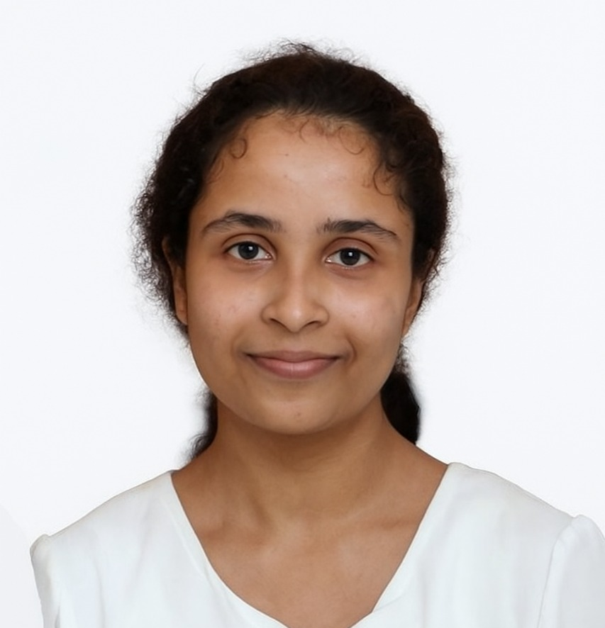
Our Team
Meet the dedicated individuals driving this innovative project:
Sandeepa S.A.C.
Siriwardhana N.S.T.N.
Madushanka H.M.T.G.
Thalagala T.A.D.V.
AI Fabric Classification Module
Environmental Impact Prediction Module
Traceability, Recommendation & AI Pricing Module
Marketplace Platform & Predictive Analytics Module

Slide 4

Introduction
Sri Lanka’s textile and apparel industry generates a large amount of fabric waste during:
Fabric cutting
Production processes
Quality control operations
Due to the absence of a transparent and scalable redistribution system, much of this textile waste is:
Burned by manufacturers
Disposed of in landfills
This leads to:
Environmental pollution
Increased carbon emissions
Loss of reusable textile resources
At the same time, small-scale designers, artisans, and SMEs struggle to access affordable raw materials for sustainable production.

Slide 5

The Research Problem
Current textile waste management systems have several limitations:
As a result:
Manufacturers lose potential revenue
Buyers cannot find a reliable waste supply
Environmental damage increases
Manual sorting is inconsistent, slow, and subjective
No automated classification of textile waste
No AI-based pricing or recommendation systems
Lack of traceability mechanisms
No environmental impact tracking
Statistical Evidence
Global textile waste: 92 million tons annually
Less than 15% is recycled
Sri Lanka’s apparel industry contributes ~7% to GDP, but produces significant unused textile waste

Slide 6
Research Objectives
Main Objective
Develop and evaluate an AI-powered digital marketplace that enables intelligent classification, valuation, environmental impact analysis, and redistribution of textile waste in Sri Lanka, promoting circular economy principles.
1
Specific Objectives
1
Module 1 – AI Fabric Classification (Sandeepa)
2
Module 2 – Environmental Impact Prediction - (Siriwardhana)
3
Module 3 – Traceability, Recommendations & AI Pricing - (Madushanka)
4
Module 4 – Marketplace Platform & Predictive Analytics - (Thalagala)

Slide 7
System Overview
Our proposed system architecture integrates AI-powered modules into a seamless digital marketplace, driving efficiency and sustainability in textile waste management.
All core modules communicate efficiently through FastAPI microservices, ensuring modularity, scalability, and robust performance across the entire platform.

Slide 8
Individual Component
AI-Driven Fabric Classification and
Cataloguing Module
Student: Sandeepa S.A.C
Student ID: IT22281814
Project ID: R26-IT-081

Slide 9
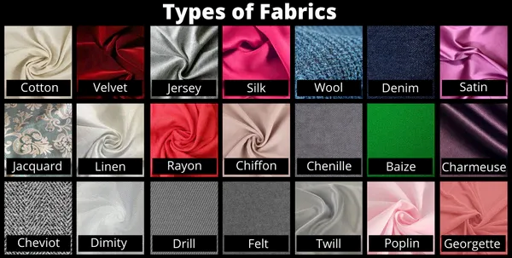
Background:
Most textile factories rely on manual visual inspection to
sort fabric waste based on:
Fabric type
Colour
Quality grade
This process is:
Time-consuming
Inconsistent
Highly subjective
Computer vision, utilizing Convolutional Neural Networks (CNNs), can automatically recognize fabric characteristics even in crumpled or folded waste materials.

Slide 10
Research Problem
  Manual textile-waste sorting has several challenges:
1
Time-consuming
Subjective human judgement
High classification error rate
2
Additionally,
Many existing AI models are trained on clean laboratory fabric samples, which perform poorly on real-world post-industrial textile waste.

Slide 11
Research Gap
Our project directly addresses critical limitations in current textile waste management by leveraging advanced AI techniques tailored for real-world scenarios.
Feature
Existing Solutions
Proposed Module
Waste Classification
Manual / expensive hyperspectral methods
CNN with transfer learning
Dataset
Clean lab images
5,000+ real textile-waste images
Real-World Performance
Low accuracy on crumpled samples
Target >85% accuracy

Slide 12
Research Objectives
Main Objective
Develop a deep learning model for automated textile waste classification.
Sub Objectives
Train CNN models using transfer learning
Achieve >85% accuracy
Deploy the model as a FastAPI microservice

Slide 13
System Architecture
Our module transforms raw textile waste images into structured, classified data, forming the backbone of the digital marketplace.
Image Upload
Pre-processing
CNN Model
Multi-output
JSON Response
This architecture ensures robust and accurate classification, providing essential data for pricing, recommendations, and environmental impact analysis.

Slide 14
Tools and Technologies
Our project leverages a robust stack of cutting-edge tools and frameworks to ensure high performance, scalability, and efficiency across all modules.
Programming Language
Deep Learning Frameworks
Model Techniques
Python 3.9+: The primary language for all development, chosen for its extensive libraries and AI capabilities.
TensorFlow / Keras: Industry-standard frameworks for building, training, and optimizing complex neural networks.
Transfer Learning: Utilizing pre-trained models like ResNet-50 and EfficientNetB3 for accelerated training and superior accuracy on textile data.
Deployment
Cloud Computing
FastAPI & Docker: Powering high-performance microservices and ensuring containerized, portable deployments for seamless integration.
Google Colab Pro / AWS GPU: Harnessing powerful GPU resources for intensive model training, experimentation, and scalable operations.

Slide 15
Software Requirements
Functional Requirements
Accept textile waste images (JPG/PNG format)
Perform automatic fabric classification
Predict fabric type, colour, and quality grade
Return prediction results with confidence scores via API
1
Non-Functional Requirements
2
Classification accuracy greater than 85%
API response time less than 2 seconds
Robust to lighting, background, and angle variations
Scalable deployment using Docker and FastAPI

Slide 16
Work Breakdown Structure
Our project's systematic approach ensures a clear roadmap from research to deployment
for the AI Fabric Classification module.
1
Literature Review
Comprehensive study of existing AI models and textile waste management techniques.
2
Data Collection & Labeling
Gathering and annotating a diverse dataset of Sri Lankan textile waste images.
3
Data Augmentation
Expanding the dataset through various techniques to improve model robustness.
4
CNN Baseline Model Development
Building an initial Convolutional Neural Network model for classification.
5
Transfer Learning & Fine-tuning
Adapting pre-trained models (ResNet-50, EfficientNetB3) for enhanced accuracy.
6
API Development & Docker Deployment
Creating a FastAPI microservice and containerizing for scalable integration.

Slide 17
Gantt Chart:
Our project's detailed timeline outlines the key phases for developing the AI Fabric Classification module, from data preparation to final deployment.

Slide 18

Individual Component
Environmental Impact Prediction Module
Student: Siriwardhana N.S.T.N
Student ID: IT22215338
Project ID: R26-IT-81

Slide 19
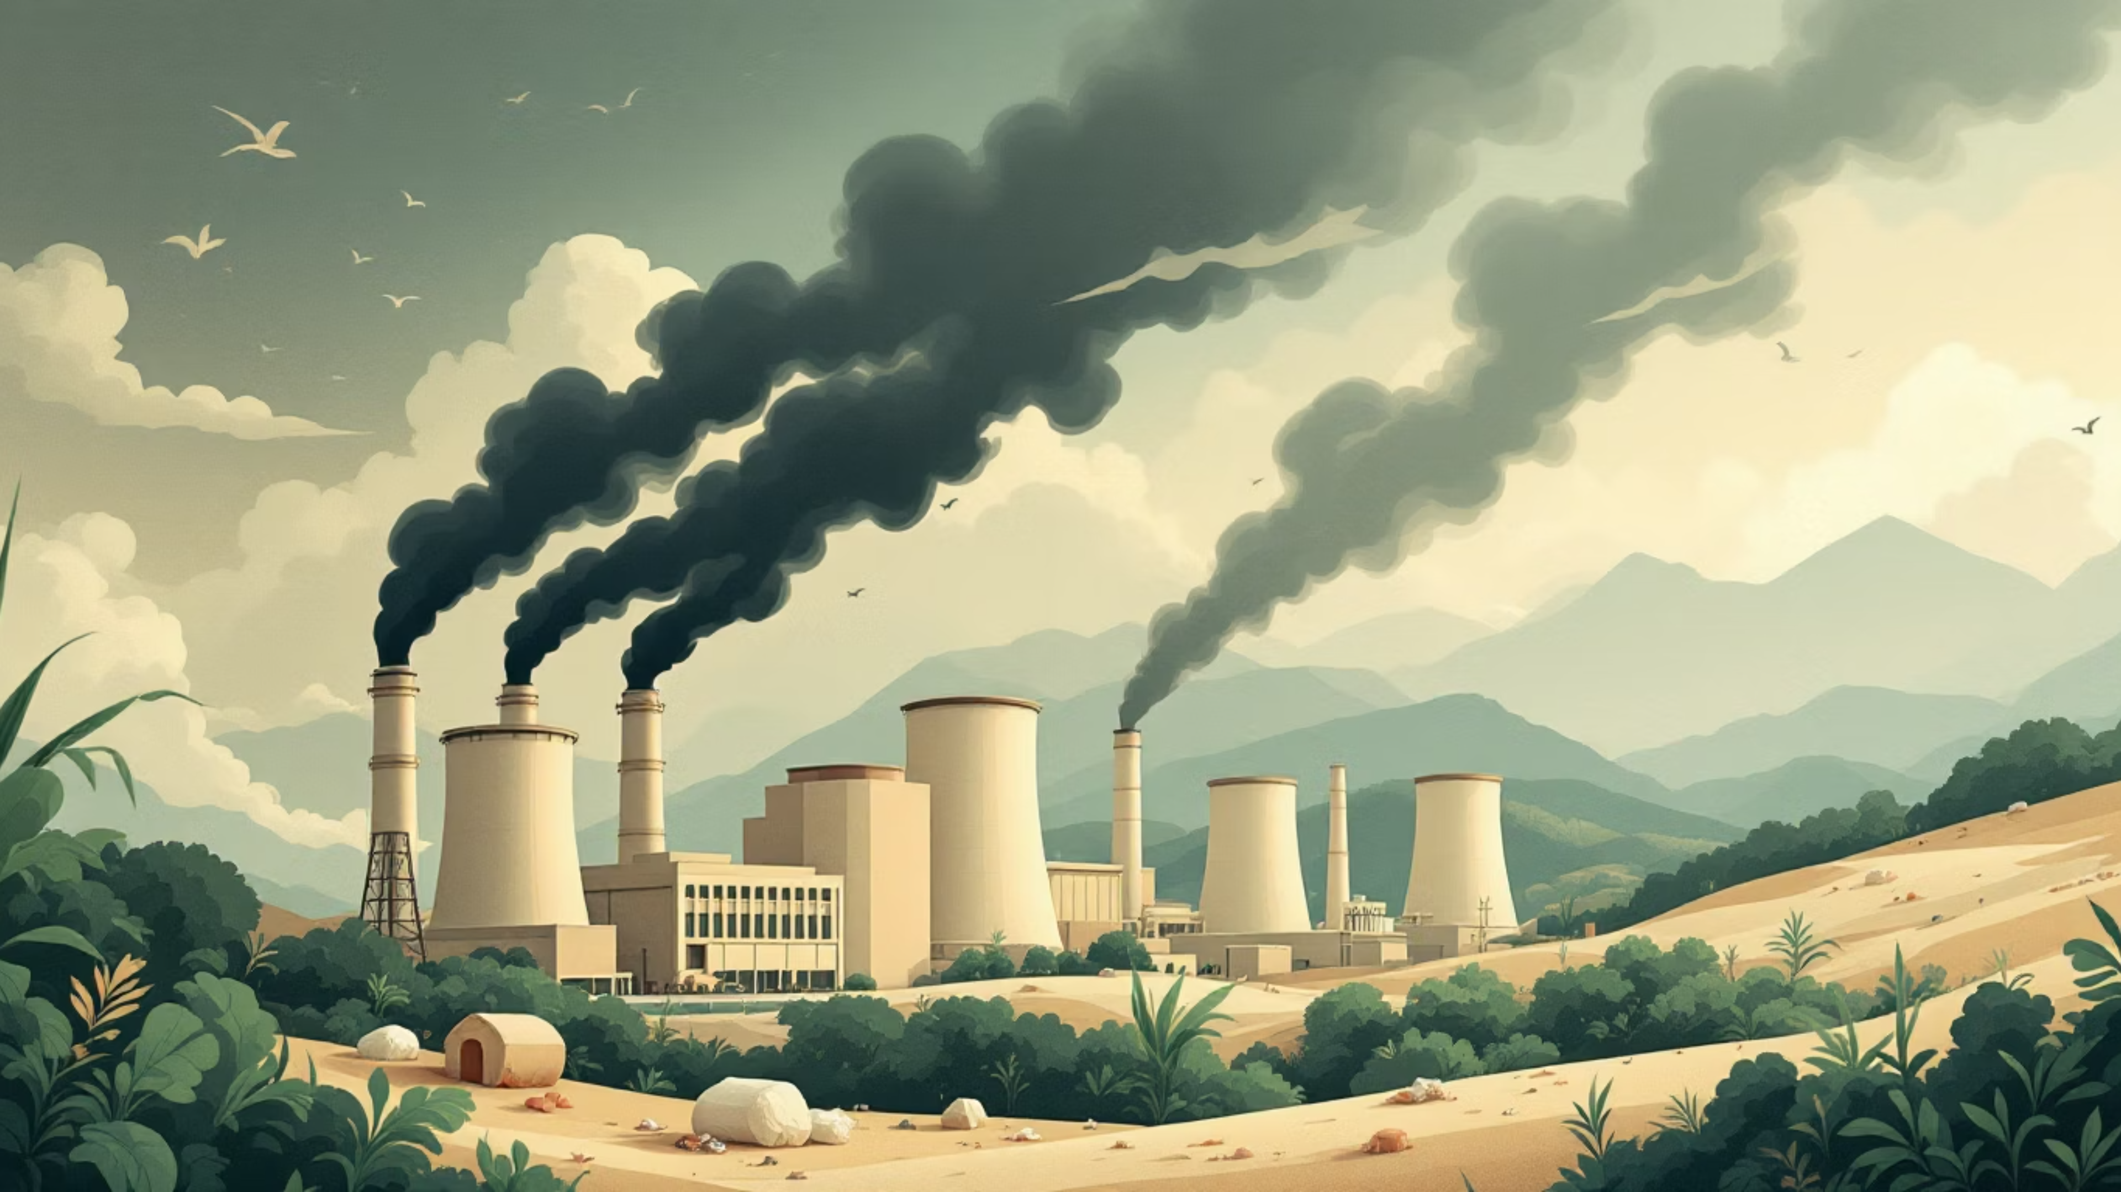

Background
Textile manufacturing consumes large amounts of:
Water
Energy
Raw materials
Producing new fabrics results in:
High carbon emissions
Large water consumption
Environmental degradation
Reusing textile waste can significantly reduce these environmental impacts.
However, most waste trading platforms do not provide environmental impact measurements

Slide 20

Research Problem
Manufacturers and buyers cannot clearly measure the environmental benefits of reusing textile waste.
Key issues include:
No automated calculation of CO₂ emission savings
No estimation of water consumption reduction
No sustainability scoring mechanism
As a result, organizations lack crucial data to evaluate the true environmental benefits.

Slide 21
Research Gap
Feature
Existing Solutions
Proposed Module
Environmental Metrics
Not available
CO₂ and water savings
Calculation Method
Manual LCA analysis
LCA dataset + ML regression
Sustainability Score
Not available
Green Score (A–F / 1–100)

Slide 22
Research Objectives
Main Objective
Develop a machine learning model that predicts environmental benefits from textile waste reuse, empowering sustainable choices.
Sub Objectives
Collect Life Cycle Assessment (LCA) environmental data
Engineer features such as fabric type, weight, and quality
Train regression models to predict environmental savings
Deploy the model as a FastAPI microservice

Slide 23
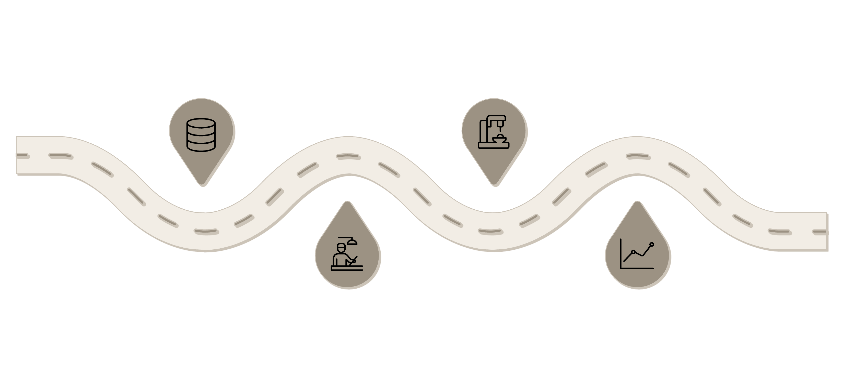




System Architecture
This module processes raw data to quantify the environmental impact of textile waste reuse, providing clear and actionable sustainability metrics.
Input Data
ML Model
Fabric type, weight, quality grade
Random Forest / XGBoost predictions
Feature Processing
Output Predictions
Normalize, encode, and derive features
CO₂, water savings and green score

Slide 24


Tools and Technologies
Our Environmental Impact Prediction Module relies on a specialized set of tools and data sources to accurately quantify sustainability benefits.
Python 3.9+
ML Libraries
The core language for data processing, machine learning model development, and API implementation.
Scikit-learn & XGBoost: Powerful frameworks for building and training robust regression models to predict CO₂ and water savings.
Deployment
Key Datasets
FastAPI & Docker: Enabling high-performance API services and ensuring consistent, portable deployment of our environmental prediction model.
LCA & Higg MSI: Foundational datasets providing crucial environmental impact metrics for accurate model training and validation.

Slide 25

Software Requirements
For the Environmental Impact Prediction Module
1
Functional Requirements
Calculate environmental impact savings
Predict CO₂ emission reduction
Predict water usage reduction
Generate sustainability Green Score
2
Non-Functional Requirements
Prediction accuracy R² > 0.85
Response time < 2 seconds
Scalable API service

Slide 26






Work Breakdown Structure
This outlines the systematic approach for developing the Environmental
Impact Prediction Module, from research to deployment.
Literature Review
Comprehensive study of existing methodologies for quantifying environmental impact and relevant Life Cycle Assessment (LCA) studies in textiles.
Data Collection & Curation
Sourcing and compiling Life Cycle Assessment (LCA) datasets specifically for textile materials and manufacturing
processes.
Feature Engineering
Transforming raw LCA data and textile properties (type, weight, quality grade) into a clean, model-ready dataset
for training.
Model Training
Developing and training robust regression models, such as Random Forest and XGBoost, to accurately predict CO₂ and water savings.
Evaluation & Optimization
Rigorous testing of model performance metrics (e.g., R², RMSE), fine-tuning hyperparameters, and ensuring predictive accuracy and reliability.
API Development & Deployment
Building a high-performance FastAPI microservice and containerizing it with Docker for scalable and consistent
deployment.

Slide 27
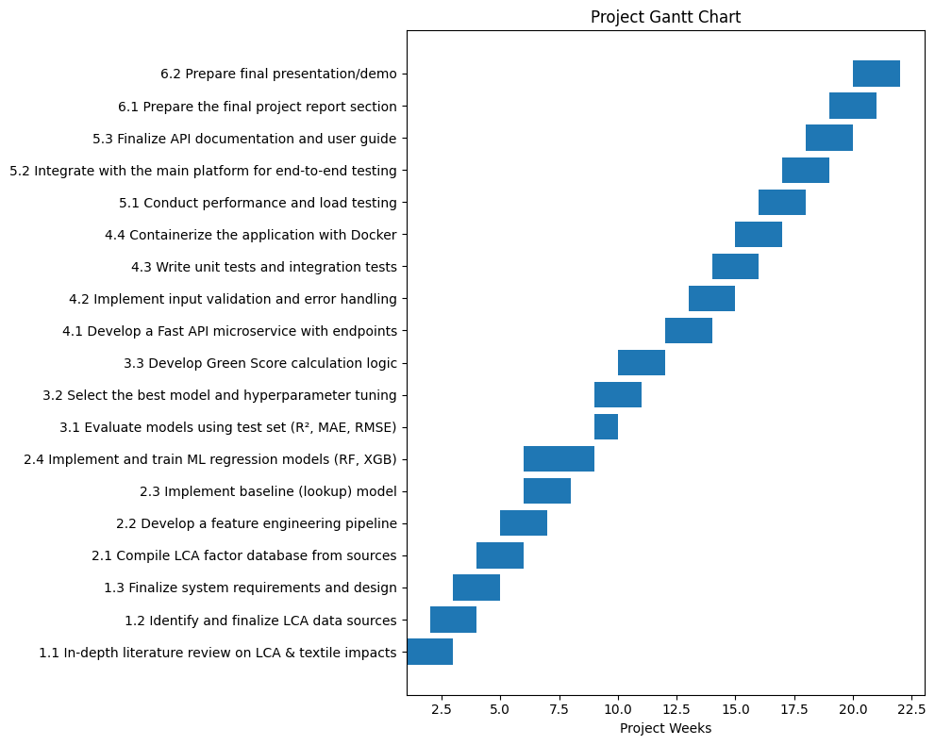
Gantt Chart: Weeks
Our detailed timeline for the Environmental Impact Prediction Module ensures a structured approach from data acquisition to final deployment.

Slide 28
Individual Component
Traceability, Recommendation & AI
Pricing Module
Student: Madushanka H.M.T.G
Student ID: IT22221278
Project ID: R26-IT-81

Slide 29

Background
In textile waste trading, transparency and pricing accuracy are critical.
Current waste trading processes suffer from:
Lack of traceability
Manual pricing decisions
Limited buyer-seller matching
Integrating AI pricing, recommendation systems, and traceability can significantly improve efficiency and trust.

Slide 30

Research Problem
Existing platforms lack:
Digital traceability of textile waste origin
AI-driven pricing models
Intelligent recommendation systems for buyers
These limitations lead to:
Unfair pricing
Lack of trust between buyers and sellers
Inefficient waste trading processes

Slide 31
Research Gap
Existing platforms struggle with crucial aspects of textile waste trading, highlighting a clear need for advanced solutions.
Feature
Existing Platforms
Proposed Module
Traceability
None
Digital material passport
Pricing
Manual estimation
AI regression pricing
Recommendations
Not available
AI recommendation engine
Our module directly addresses these limitations by integrating robust digital solutions.

Slide 32


Research Objectives
Main Objective
Develop a system that provides traceability, intelligent pricing, and recommendations for textile waste trading.
Sub-Objectives
Create a digital material passport for waste batches
Develop an AI-based pricing prediction model
Implement a recommendation system for buyers
Deploy services through FastAPI APIs

Slide 33
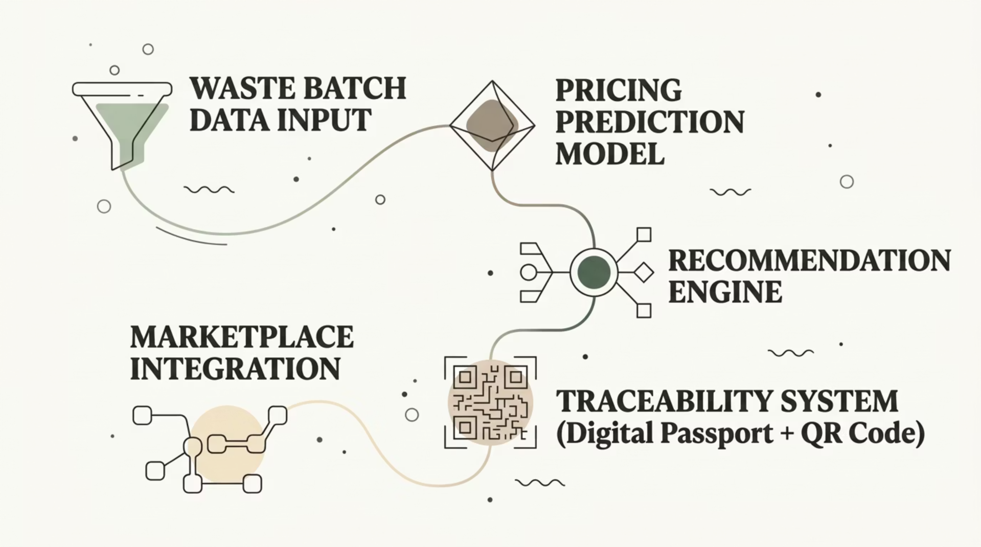

System Architecture
This module integrates advanced AI with traceability to optimize the textile waste trading process, ensuring fair pricing and efficient matching.

Slide 34




Tools and Technologies
For the Traceability, Recommendation & AI Pricing Module
Python
The primary programming language, serving as the backbone for backend logic, A
I model development, and data processing.
Scikit-learn
Utilized for developing robust machine learning models for AI pricing
prediction and recommendation algorithms.
XGBoost
A powerful gradient boosting library employed for enhanced accuracy and
performance in complex predictive tasks.
FastAPI
The high-performance web framework for building efficient and scalable API
services for our module.
QR Code Generation
Enables the creation of digital material passports for textile waste batches,
ensuring full traceability.
Docker Deployment
Containerization technology used to ensure consistent, portable, and
scalable deployment of all module services.

Slide 35
Software Requirements
Our module's design is guided by specific functional and non-functional requirements to ensure optimal performance and user value.
Functional Requirements
Non-Functional Requirements
Predict resale price
Generate buyer recommendations
Provide traceability passport
Generate QR code for batch tracking
Secure and transparent data handling
Accurate price prediction
High system reliability

Slide 36

Work Breakdown Structure
Our project's Work Breakdown Structure clearly outlines the key phases and deliverables, ensuring a systematic and manageable approach to development.
1
Dataset Collection
Gathering and curating all necessary data for model training and system functionality.
2
Feature Engineering
Transforming raw data into meaningful features to enhance model performance.
3
Pricing Model Training
Developing and optimizing the AI-driven pricing prediction model.
4
Recommendation Engine Development
Building the AI-powered system for intelligent buyer-seller matching.
5
Traceability System Development
Implementing the digital material passport and QR code tracking.
6
API Integration & Deployment
Connecting all components via FastAPI and deploying the module for production.

Slide 37
Gantt Chart: Weeks 4–22
This detailed Gantt chart outlines the development timeline for the Traceability, Recommendation & AI Pricing Module, from initial data collection to final deployment.

Slide 38

Individual Component
Marketplace Platform & Predictive Analytics Module
Student: Thalagala T.A.D.VStudent ID: IT22281678Project ID: R26-IT-081

Slide 39

Background
There is currently no centralized digital platform dedicated to textile waste trading in Sri Lanka.
A digital marketplace can:
Connect manufacturers and buyers
Improve waste reuse efficiency
Provide environmental impact information
Support circular economy practices.

Slide 40

Research Problem
Existing marketplaces:
  Are not specialized for textile waste
  Do not integrate AI models
  Do not provide predictive analytics for waste generation
This limits the ability of stakeholders to plan sustainable waste management strategies.

Slide 41
Research Gap
While progress has been made, current platforms fall short in addressing the specialized needs of textile waste management. Our module aims to bridge these critical gaps.
Feature
Existing Platforms
Proposed Module
Marketplace
Generic e-commerce
Specialized textile waste marketplace
Forecasting
None
ML waste prediction
Dashboard
Limited analytics
Interactive analytics dashboard
This table highlights how our specialized module offers advanced capabilities precisely where current solutions are lacking, focusing on intelligent features crucial for a circular economy.

Slide 42

Research Objectives
Main-Objectives
Our main objective is to develop an integrated digital marketplace platform with
Predictive analytics capabilities for upcycling Sri Lanka's textile waste.
Sub-Objectives
1
Develop React-based marketplace interface
Create a user-friendly and responsive front-end for seamless interaction between
buyers and sellers.
2
Build waste forecasting machine learning models
Implement AI models to accurately predict future textile waste generation and
availability.
3
Create analytics dashboard for trends
Provide an interactive dashboard displaying key insights and trends in textile waste
data.
4
Integrate all AI modules into the platform
Ensure smooth and efficient communication between the various AI components
and the core marketplace system.

Slide 43
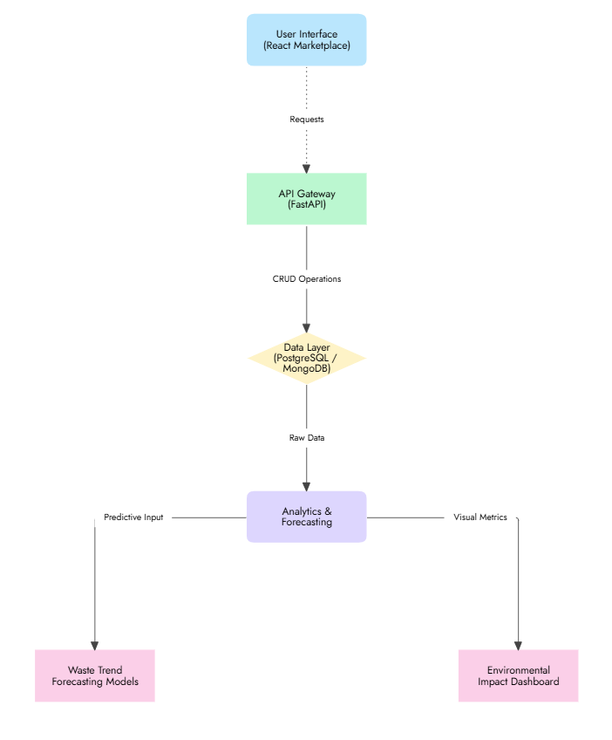
System Architecture
Our system architecture is designed for scalability and efficiency, connecting user interfaces with intelligent backend services through a robust API gateway.
This modular approach allows for independent development and deployment of each component, ensuring system resilience and ease of maintenance.

Slide 44

Tools and Technologies
Our platform leverages a robust and modern technology stack to ensure scalability, efficiency, and seamless integration across all components.
Frontend
Databases
Deployment
React.js
Tailwind CSS
MongoDB
PostgreSQL
Docker
Backend
Machine Learning
FastAPI
Scikit-learn
XGBoost

Slide 45
Software Requirements
Our platform is designed with a clear set of functional and non-functional requirements to ensure a robust, user-friendly, and scalable solution for textile waste management.
Functional Requirements
Non-Functional Requirements
User registration: Secure profiles for buyers and sellers.
Waste listing: Detailed descriptions and categorization of textile waste batches.
Search and filtering: Advanced options for efficient discovery of materials.
Environmental impact visualization: Data-driven insights on sustainability metrics.
Analytics dashboard: Interactive charts and reports for market trends and performance.
Scalable architecture: Designed to handle increasing user and data loads.
User-friendly interface: Intuitive design for ease of use across all functionalities.
High availability: Ensures continuous access and minimal downtime.
Secure and transparent data handling: Protects sensitive information and builds trust.
Accurate price prediction: Reliable AI models for fair market value.
High system reliability: Consistent performance and data integrity.

Slide 46
Work Breakdown Structure
Our project execution is meticulously planned through a Work Breakdown Structure, detailing each major phase from initial analysis to final deployment.
Requirement Analysis
Forecasting Dataset Preparation
Thoroughly defining the functional and non-functional requirements for the platform.
Collecting, cleaning, and preparing historical and real-time data for ML model training.
ML Model Development
Dashboard Design
Designing, training, and validating machine learning models for waste forecasting and pricing.
Creating an intuitive and interactive analytics dashboard for visualizing key metrics.
Frontend Development
API Integration and Deployment
Building the user-facing marketplace interface with React.js and Tailwind CSS.
Connecting all components via FastAPI and deploying the entire system using Docker.

Slide 47
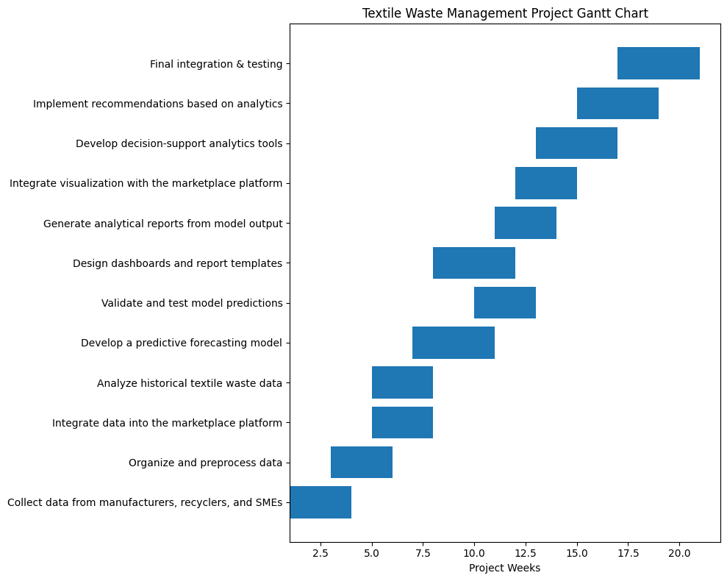
Gantt Chart: Weeks

Slide 48
Conclusion
This project proposes an AI-powered digital marketplace for upcycling textiles
waste in Sri Lanka, offering a comprehensive solution to address the nation’s
textile waste crisis.
Intelligent Classification
Automated identification and categorization of textile waste.
Environmental Impact Measurement
Quantifying the positive ecological contribution of upcycling.
Transparent Traceability
End-to-end visibility of waste materials through the supply chain.
Data-Driven Insights
Optimized pricing and personalized recommendations for users.
Sustainable Trading Platform
A dedicated marketplace fostering circular economy practices.
Ultimately, this system promotes robust circular economy practices and significant
environmental sustainability for Sri Lanka's textile industry.

Slide 49
Thank You!
AI-Powered Digital Marketplace for Upcycling Sri Lanka's Textile Waste
R26-IT-081

